Slide 1
CLIMATE CHANGE, ENVIRONMENT & MILITARISM November 14 2015
«Introduction on short and long –term environmental damage from weapons production, testing and use» – and a little more
K. Margrethe K. Tingstad, President WILPF Norway Vice president WILPF International

Slide 2
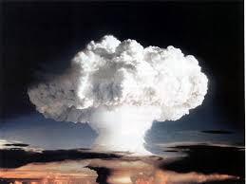
Some aspects of militarism’s impact on the environment
Direct and indirect effects
Collateral effects, operational effects
Use of terrorim as a weapon
Immediate and long term
During war, post conflict and peace

Slide 3
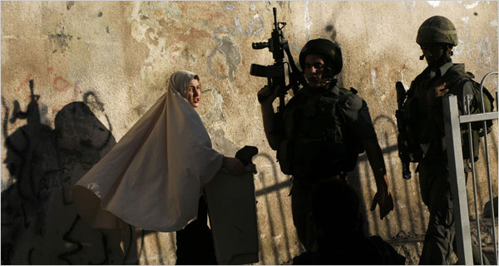
Military activities
Weapons research and development, production, testing, storage, disposal
Military training
Use of armed force in war, civil wars and civil disturbances
Militarism
Strong belief in military solutions to conflicts => military spending
Prevalence of patriarchal, military oriented attitudes and practices => armed violence and violent masculinity.
Notes:
General on what we assosiate with the term – militarisic governments etc. whereas the two point above are the ones to focus on here.
3

Slide 4
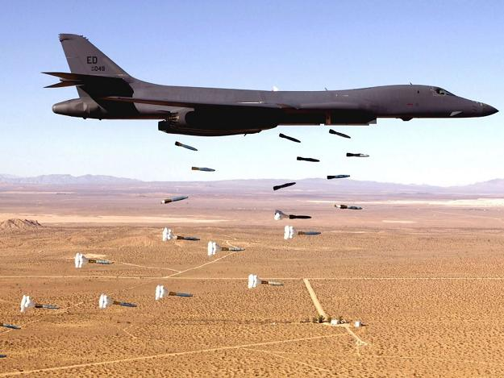
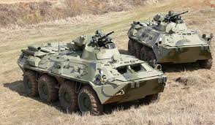
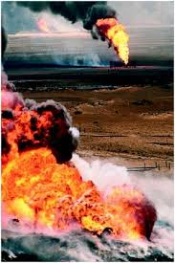
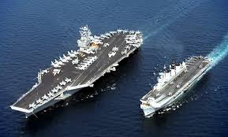
Military activity and short term impacts on the environment
Accute pollution of air, soil, water and watercourses, plants and wildlife by
High explosive weapons
Incendiary weapons
Antipersonnel mines
Biological and chemical weapons
Nuclear weapons
Emissions of greenhouse gases
Natural resources extraction

Slide 5
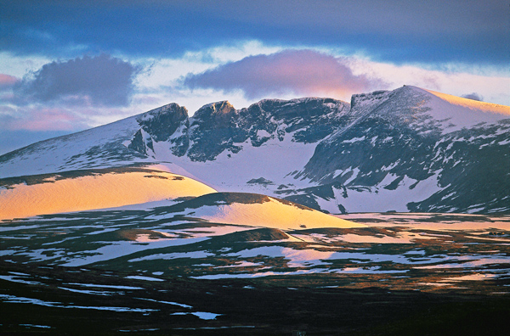
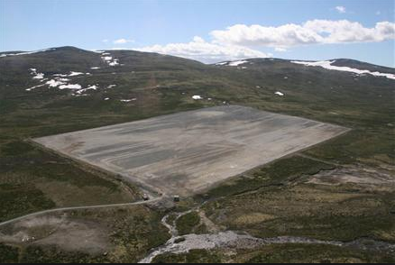
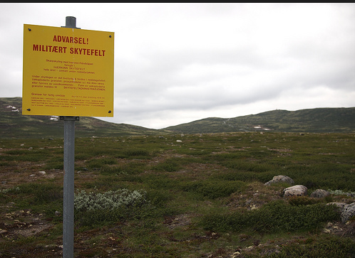
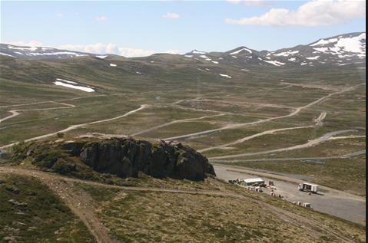
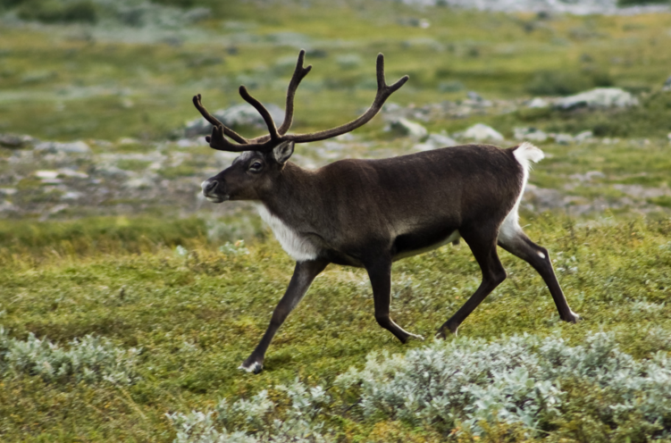
NORWAY, Dovrefjell

Slide 6
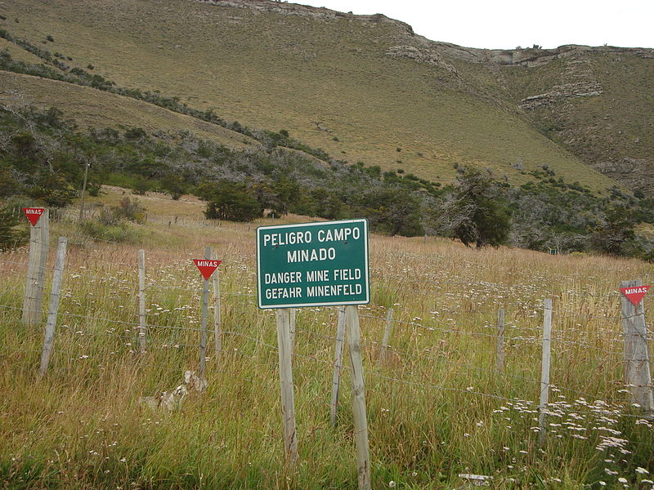
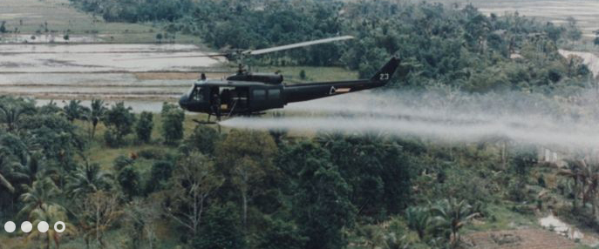
Military activity and long term environmental impacts
Toxic remnants of war, weapons testing, and peace time military activity
Land degradation
=> Water and land resouses are contaminated and degraded
=> Deforestation, erosion and desertification
Loss of biodiversity

Slide 7
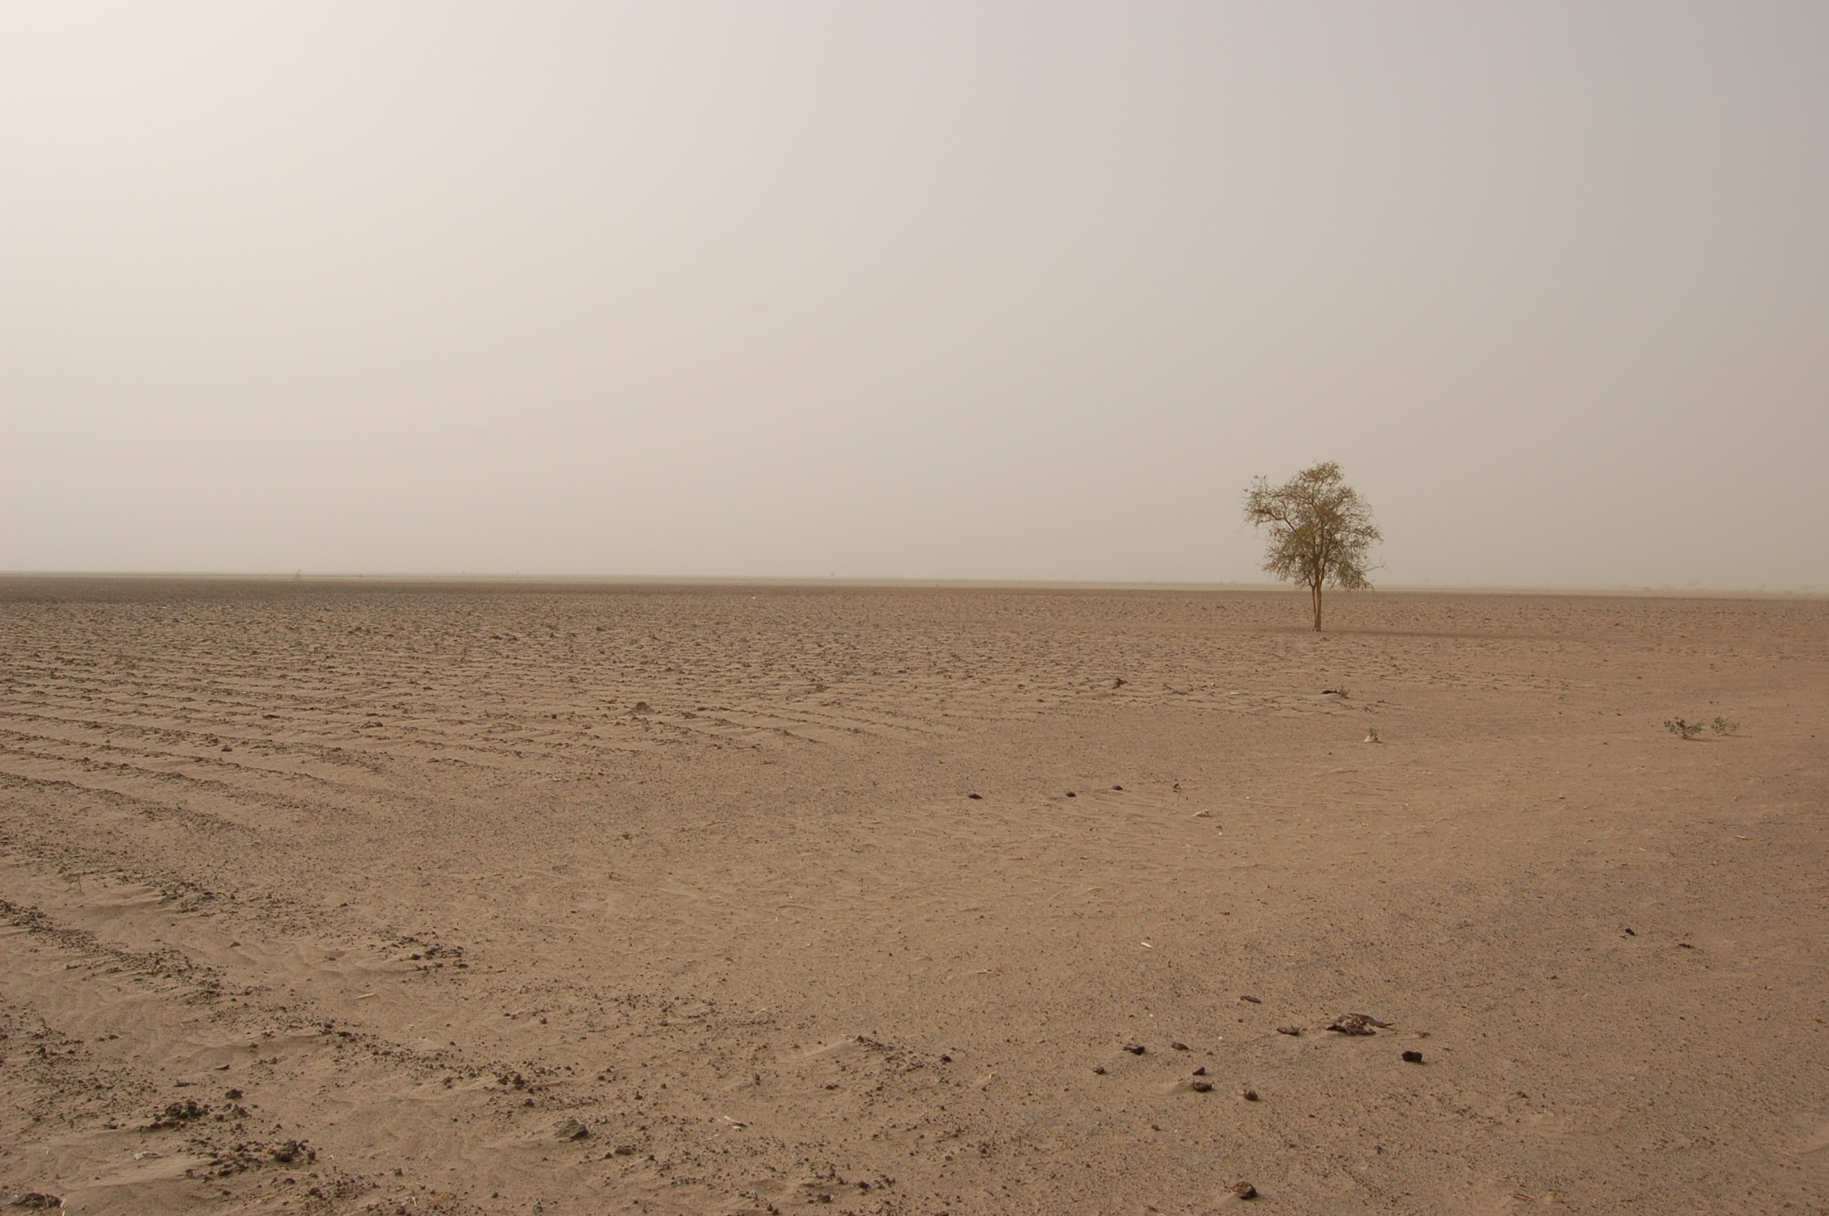
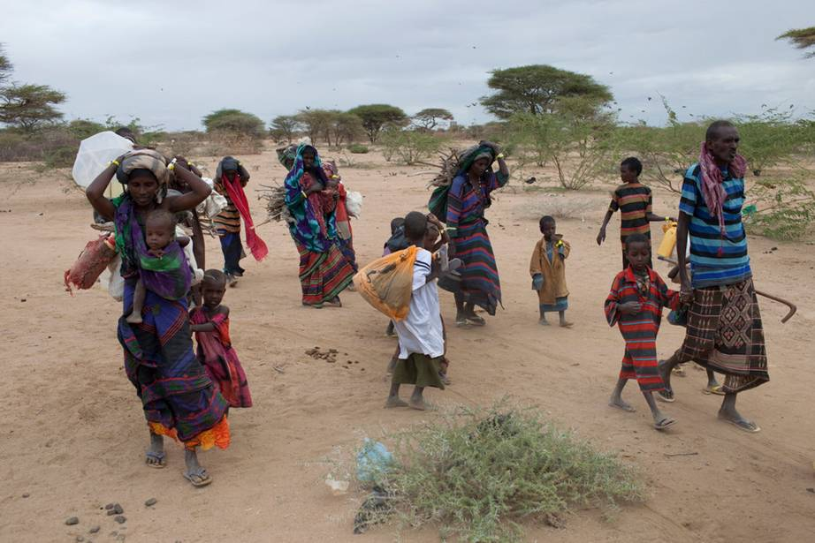
Cont. long term environmental impacts
Refugees due to war: - Erosion due to deforestation
- Loss of infrastructures
- loss of biodiversity
- Loss of local ecolocial knowledge
-
Notes:
7

Slide 8
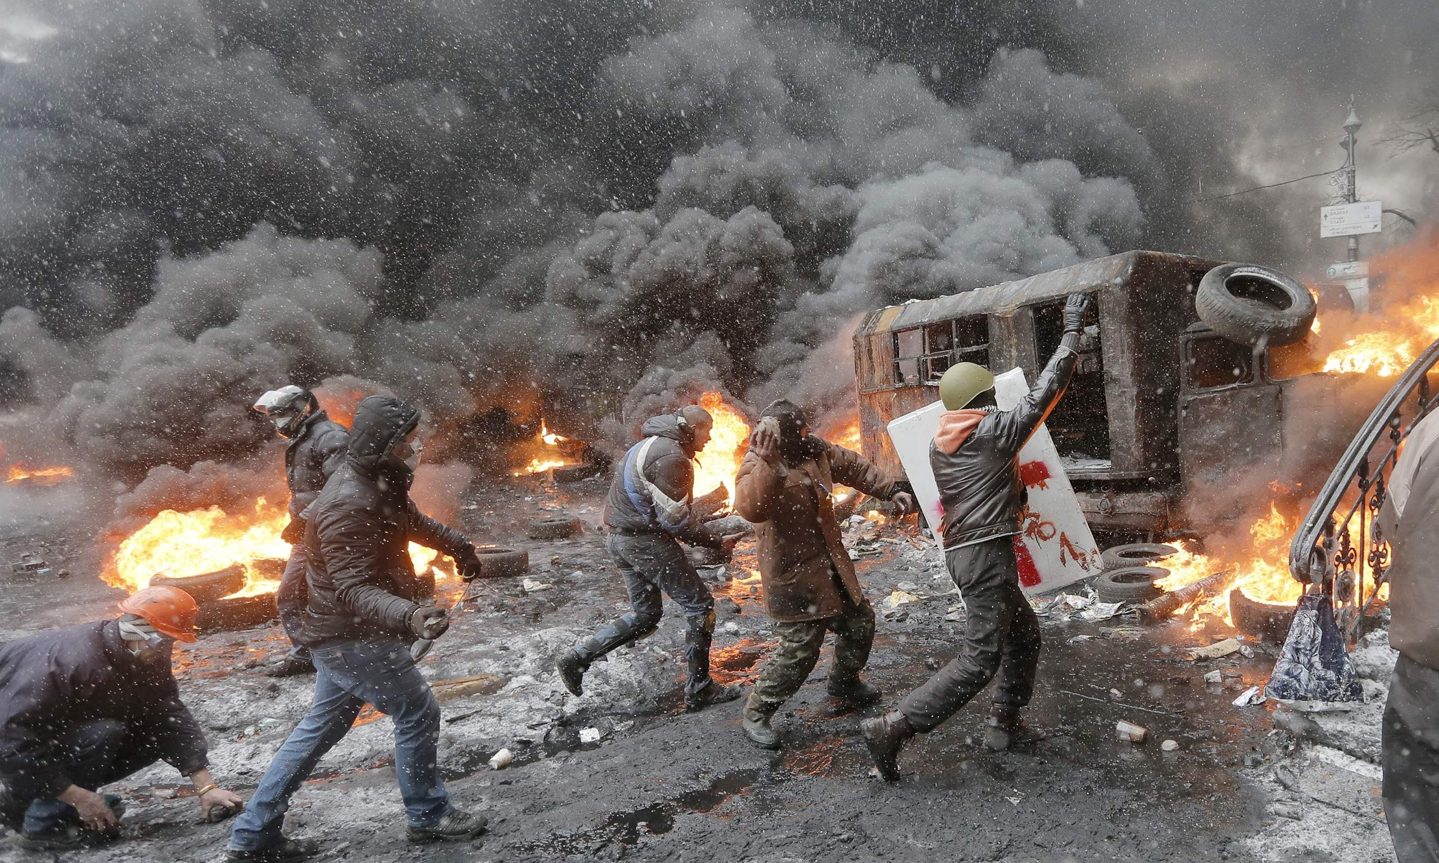

Slide 9
Militarism at the expense of human and environmental needs
Drivers: Technolgy/economy
Enormous field of business
Repurchase agreements for military equipment as part of world trade
Many developing countries invest in weapons at the expense of development, human needs and environmental protection
Military research can afford to recruit the best brains
Notes:
9

Slide 10
Militarism’s indirect impact on our ecosphere
615

Slide 11
«You cannot simultaneously prevent and prepare for war». Albert Einstein
Sustainable development
Peace and security

Slide 12
What can be done?
Abvoe all: explore and challenge the structures and institutions of armed conflict, arms production, the arms trade and MILITARISM
UN member states should develop strategies for redirecting military budgets to human need and environmental protection
International law must recognize the direct connections between environmental degradation and human rights.
Strengthen research investigate the impact of militarism and the environment
Notes:
12

Slide 13
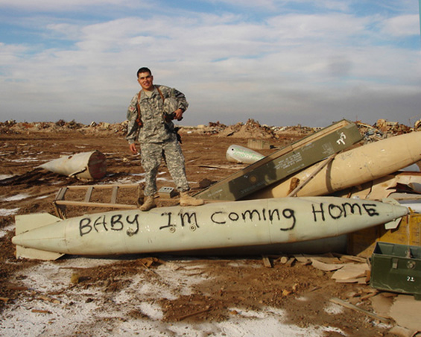
FIGHT MILITARISM!

Slide 14
Some of my sources:

