Slide 1
CLIMATE CHANGE, INSTABILITY & BORDER SECURITISATION
April Humble
Earth League
Notes:
Im going to speak a little of the scale of the growth of border securitisation globally, look at which regions this growth is taking place, and … (do I want to lay it all out so??) or do I want more of a ted talky style drama!!!??

Slide 2
Notes:
Say here what Im going to talk abtou
This is the bangladeshi-india border by the way, incidently one of the worlds most vulnerable nations to CC

Slide 3
When planet Earth’s conditions and patterns are disrupted, society will also be subject to disruption.
Notes:
I wont talk much about lcimat change and conflcit, as my specialisation is borders, but just to give a basic understanding to those who arent familiar with the idea

Slide 4
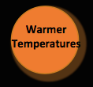
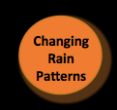
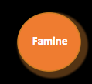
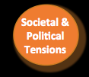
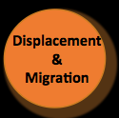
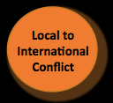

Slide 5
“Climate change is an all encompassing threat, directly affecting the environment, the economy, health and safety. Many communities face multiple stresses with serious social, political and security implications, both domestically and abroad. Millions of people are uprooted or permanently on the move as a result. Many more millions will follow.”
-Human Impact Report, 2009
200 million climate refugees
Some figures say at 2degrees conflict could increase by 50%
When rainfall is significantly below normal, risk of low-level conflict escalating to a full-scale civil war approximately doubles the following year

Slide 6
“Water flows or blood”
Slogan Pakistani political party
Jamaat-u-Dawa

Slide 7
“potentially the greatest challenge to global stability and security, and therefore to national security”
-UK’s National Security Strategy, 2008
“We are considering the impacts of climate change in our war games and defense planning scenarios, and are working with our combatant commands to address impacts in their areas of responsibility,”
-Defense Secretary, Chuck Hagel
“We have interjected into our multilateral dialogue – even with China and India – the imperative to kind of get military capabilities aligned [for] when the effects of climate change start to impact these massive populations”
Admiral Samuel J. Locklear III, head of U.S. Pacific Command (PACOM)

Slide 8
Are the states looking to actively implement military measures
in response to climate change ?

Slide 10
Global Increase in Border Security

Slide 11
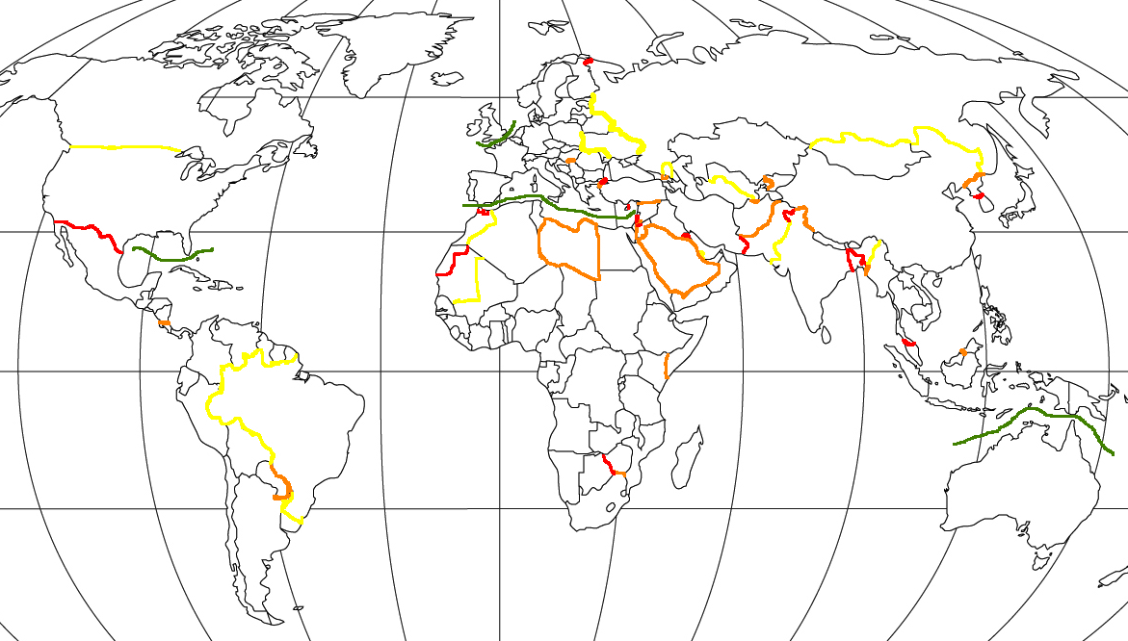
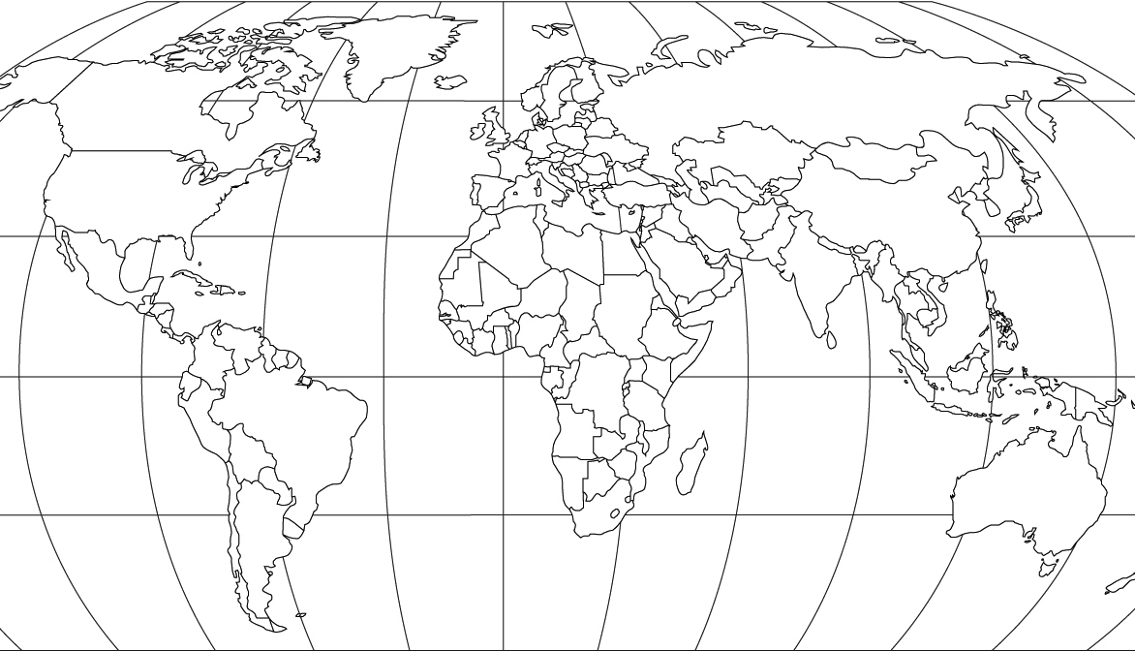
Red – robust land security Yellow –low border security
Orange- semi robust land security
Green – maritime security

Slide 12
List of Securitised Borders
Afghanistan ­ Pakistan
Botswana ­Zimbabwe
Brazil – Paraguay
Brazil- all borders
Brunei ­Limbang
Bulgaria – Turkey
Burma ­ Bangladesh
Canada ­ US
Ceuta ­ Morocco
China ­ North Korea
Costa Rica- Nicaragua
Cyprus: North – South
Europe‐Africa
Georgia- South Ossetia
Hungary – Serbia
India ­ Bangladesh
India ­ Burma
India ­ Pakistan
India ­ Tibet
Iran ­Pakistan
Israel ­ Egypt
Israel ­ Golan heights
Israel ­ Jordan
Israel – Palestinian
Kenya – Somalia
Kuwait ­Iraq
Libya ­all borders
Malaysia ­ Thailand
Mali ­ Mauritania
Melilla ­Morocco
Moldova ­ Romania
Morocco ­ Algeria
Morocco ­ Western Sahara
North Korea ­ South Korea
Qatar ­ all borders
Russia ­ Chechnya
Russia ­ China
Russia ­ Norway
Russia – Mongolia
Saudi Arabia ­ Yemen
Saudi Arabia – all borders
Saudi Arabia – Iraq
South Africa ­ Zimbabwe
Turkey ­ Greece
Turkey- Syria
UAE – Oman
UK – France
Ukraine ­ Poland
Ukraine ­ Romania
US ­ Caribbean
US ­Mexico
Uzbekistan ­ Afghanistan
Uzbekistan ­ Kyrgyzstan
Uzbekistan ­ Turkmenistan

Slide 14
Syrian conflict roots
5 year drought (2007-08), worst ever recorded
75% of livestock died
Around half of crops failed
Mass migration to cities
Youth unemployment reached around 48%
First great climate conflict and mass climate-incuded migration

Slide 17
Thousands have died in the Mediterranean this year
EU paid Turkey 1bn euro to secure borders further
Building of internal fences

Slide 18
The Border Control Industry
Total sales of 100 largest arms companies listed by SIPRI amounted to $395 billion (£234.8 billion or €289.6 billion) in 2012.
Border security market estimated to reach just under $33.6 billion (£20 billion or €24.7 billion) in 2013.

Slide 19
Raytheon
Lockheed Martin
Finmeccanica
BAE systems
Thales

Slide 20
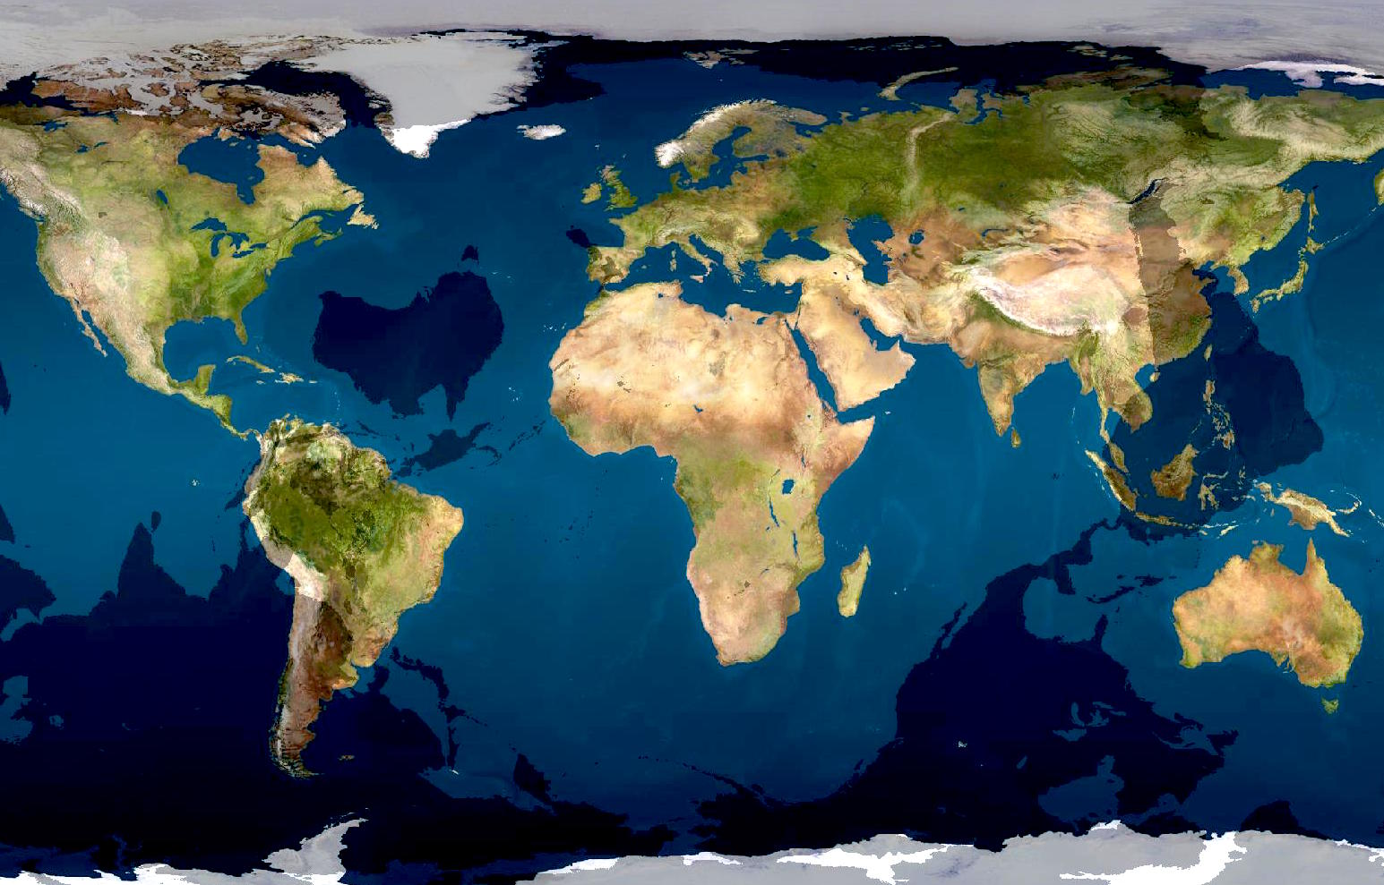
-----------------------------------------------------------------------------------------------------------------------------------------

Slide 21
“Our challenge has changed.
It is no longer about just reducing emissions.
We have to work out how to hold on to our humanity as we head to increasingly difficult times.”
Tim DeChristopher, environmental activist arrested and imprisoned for disrupting an auction of oil and gas leases in Utah in 2008.

Slide 22
Thank you
April Humble
april.humble@hzg.de
april.humble1@gmail.com
Earth League
Climate Service Center 2.0

